Slide 1
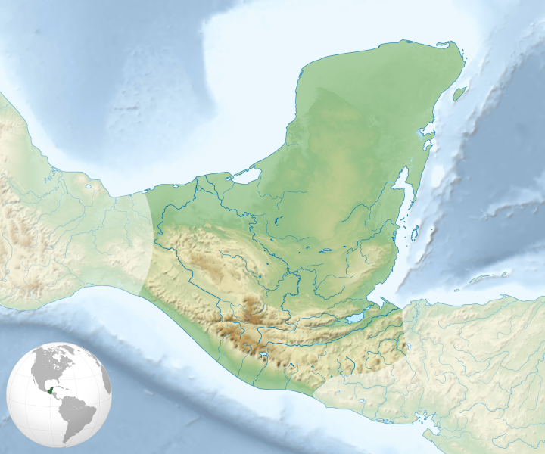
The Maya Map shows extent of Maya civilization from the Pre-Classic period (c. 2000 BC to AD 250) through the Classic period (c. AD 250 to 900)

Slide 2
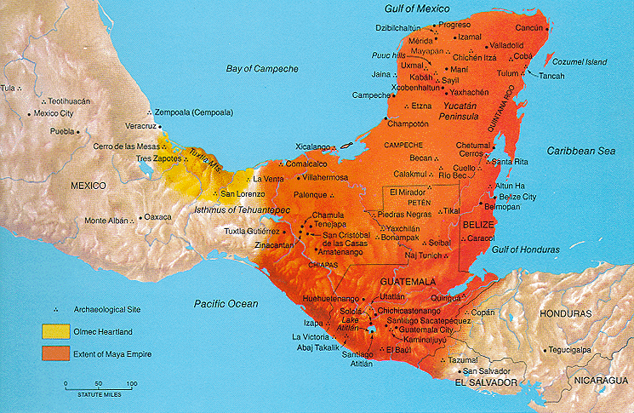

Slide 3
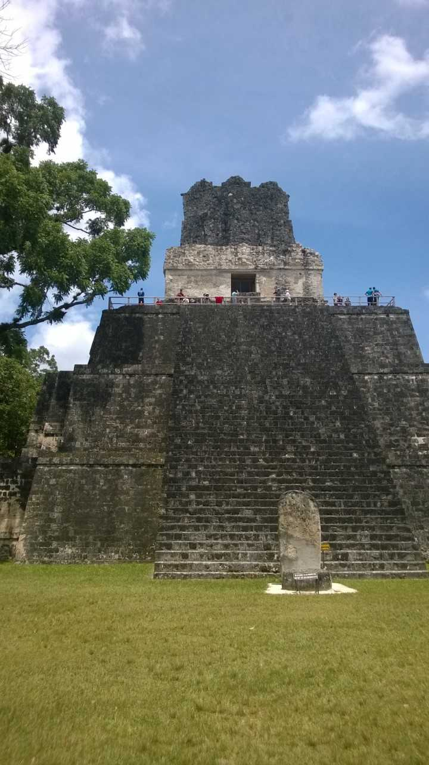
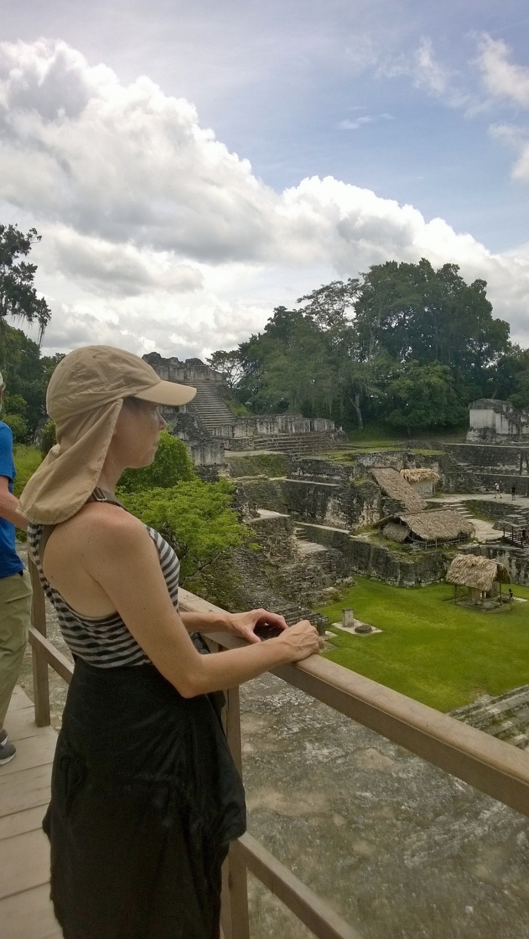
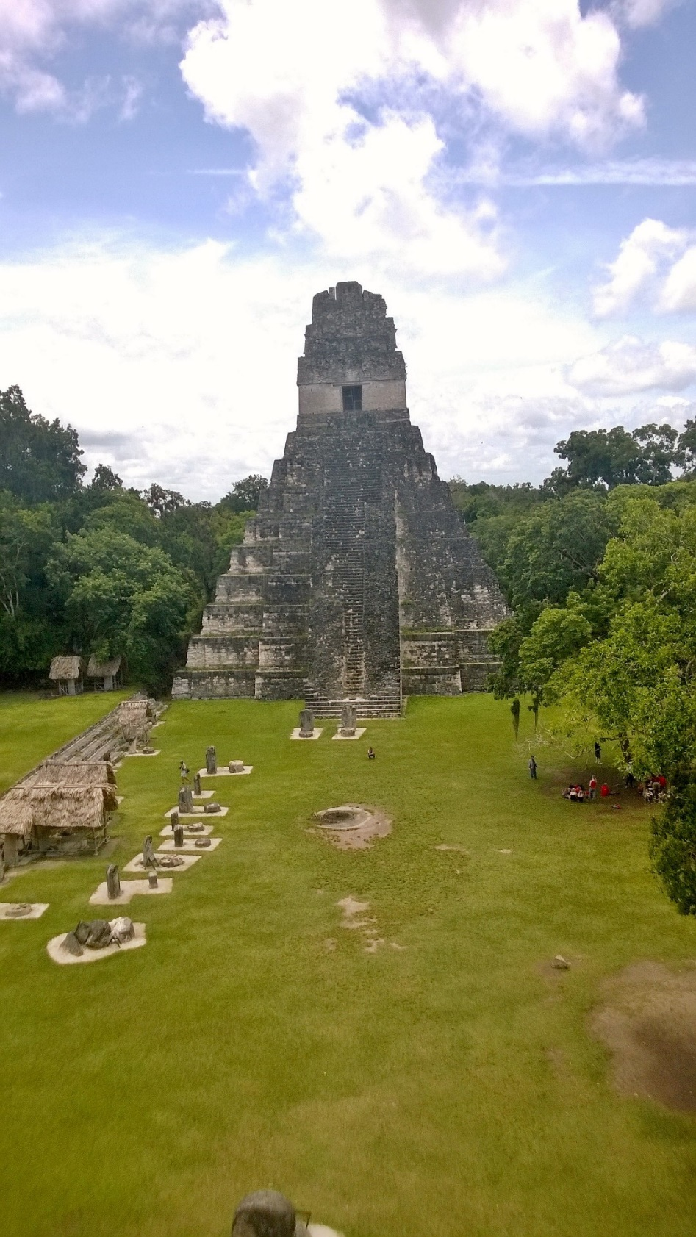
Tikal, Guatemala Capital of a Maya kingdom at its height during the Classic Period, c. 200 to 900 AD

Slide 4
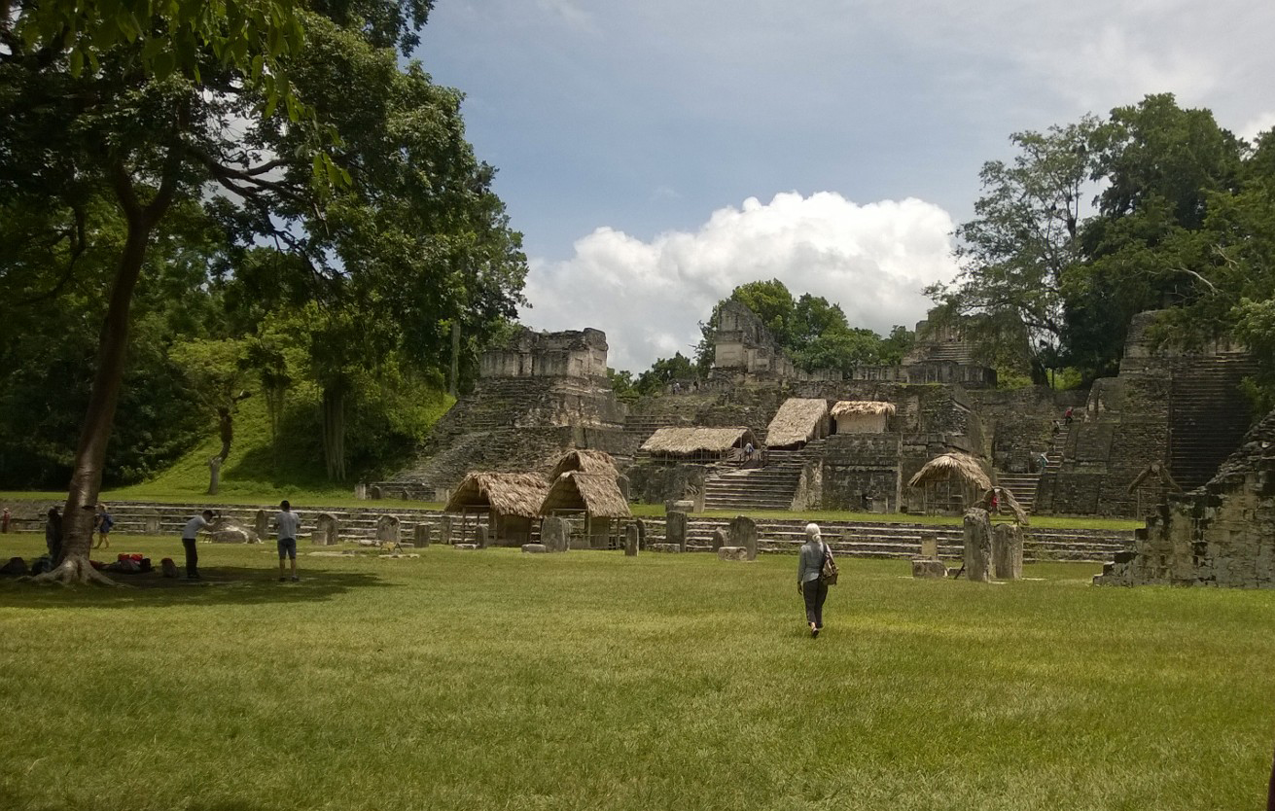
Tikal, between temples 1 and 2

Slide 5
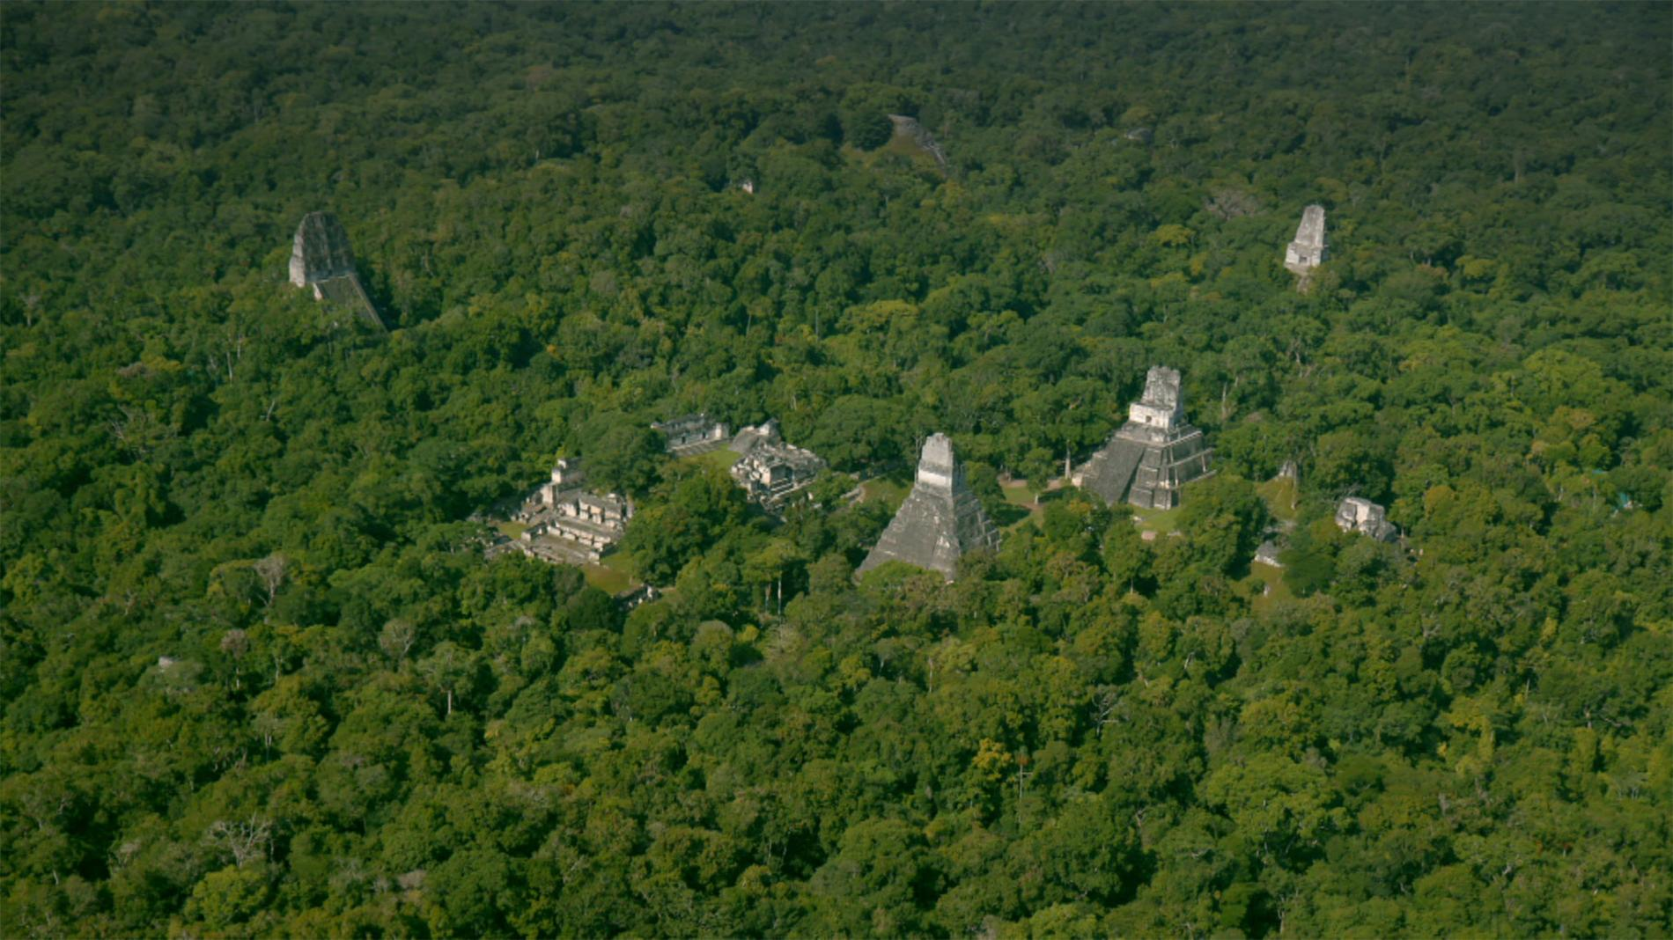
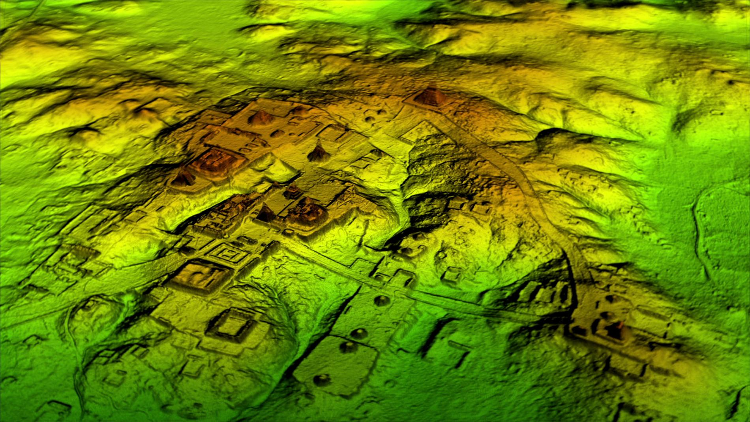
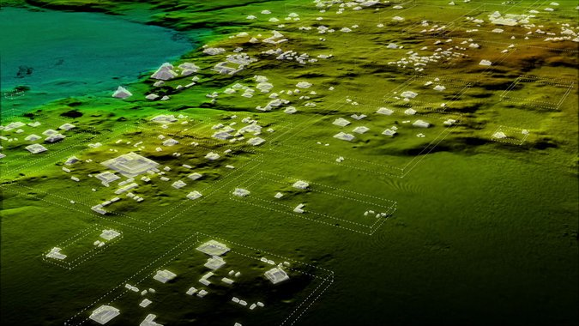
New findings! (top left) Aerial view of Tikal, Maya city in Guatemala, with 2018 lidar image (top right) and artist reconstructive drawing (left). Researchers found thousands of structures by shooting lasers down from planes to pierce the thick foliage and paint a 3-D picture of the ground below. The technology is called Light Detection and Ranging, or lidar.

Slide 6
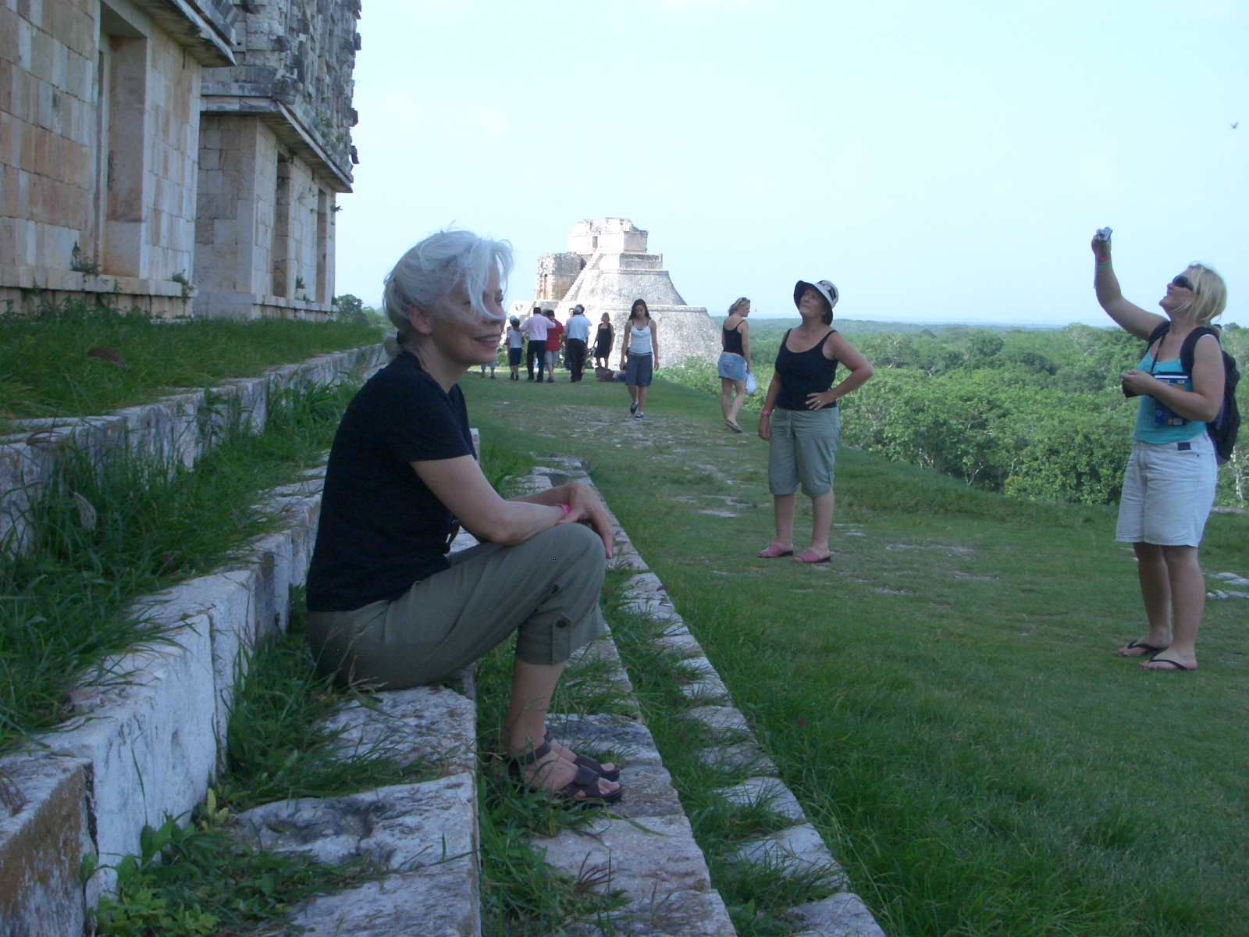
Uxmal
Dominant from 875 to 900 CE.

Slide 7
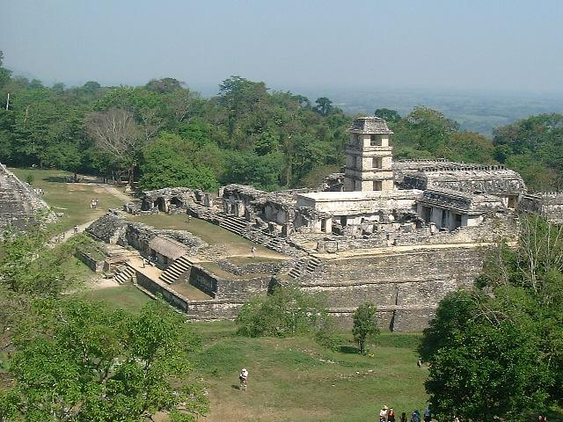
The Palenque Palace, Chiapas, Mexico, from the Temple of the Foliated Cross. Palenque was begun around 600 AD during the reign of King Pakal, his two sons, and Pakal’s grandson and great-grandson. It was the court residence and administrative center.

Slide 8
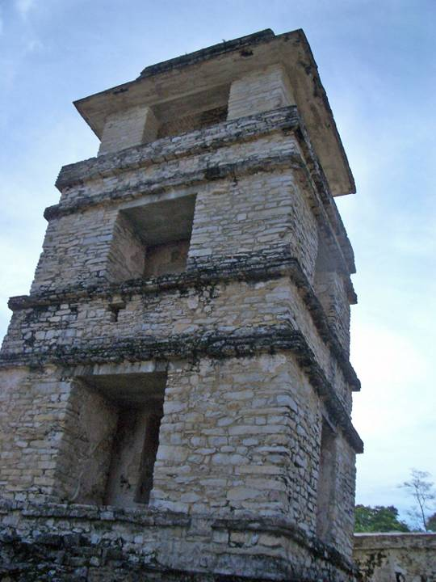
Palenque palace tower, probable use for astronomical and military observation. This is the only surviving Mayan tower.

Slide 9
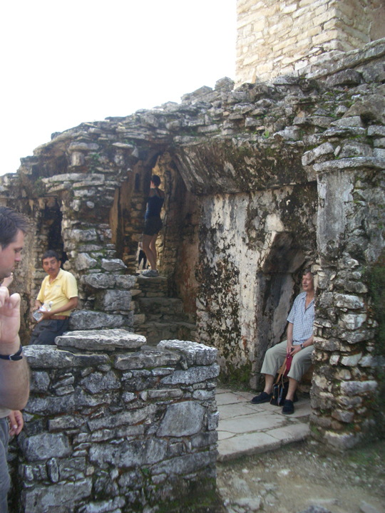
Palenque palace interior showing corbelled labyrinthine hallways and “toilet.” (The man on the right is sitting on it.) The palace was plumbed via the stream that runs under and alongside the palace

Slide 10
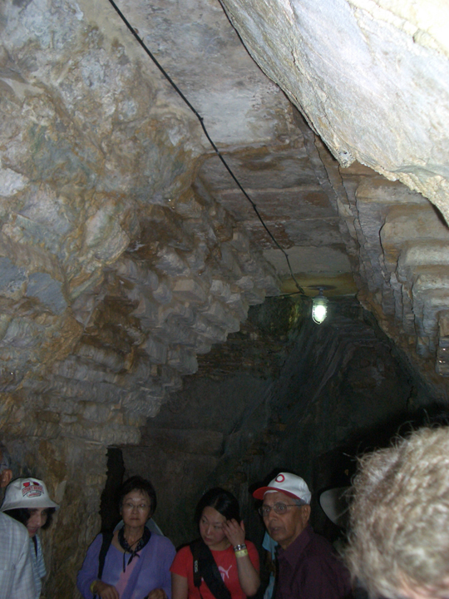
Palenque palace interior passage, 7th century, Late Classic Maya

Slide 11
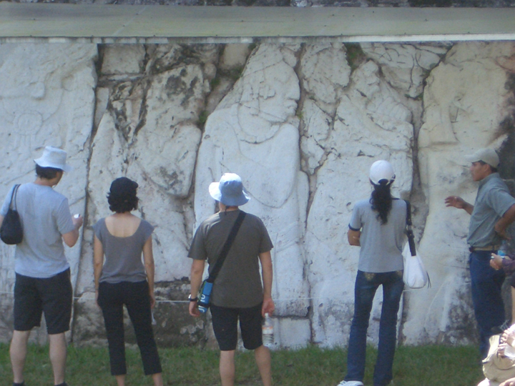
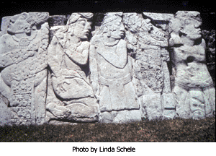
Palenque palace, east court. Individual carved slabs of captives (in postures of humiliation and showing signs of blood letting) that flank a ceremonial courtyard where Lords of the region entered to meet with Pakal and kings of his line.
http://youtu.be/-qNdnW_bi8M

Slide 12
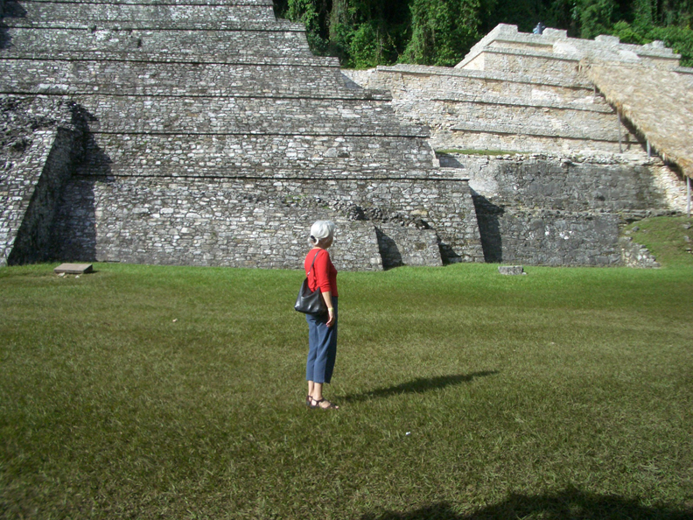
Palenque restored temples. Note grass roofing on the right.

Slide 13
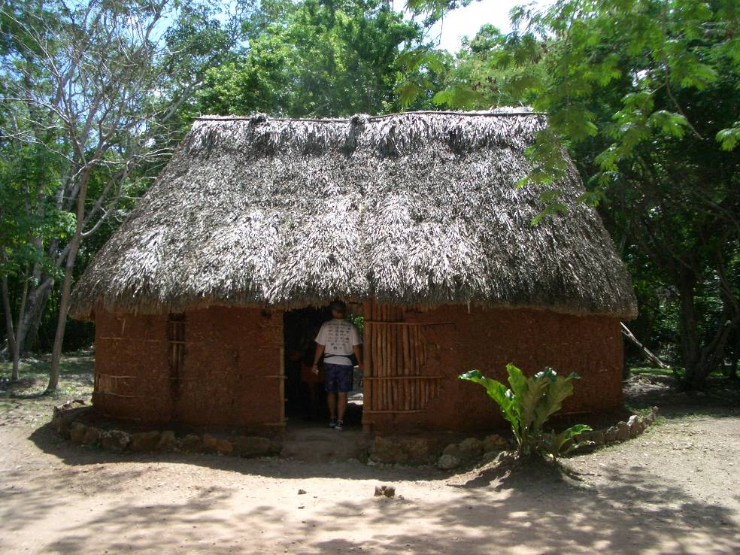
Palenque: reconstruction of Late Classic Maya peasant house
Palenque: reconstruction of a late Classic Maya peasant house

Slide 14
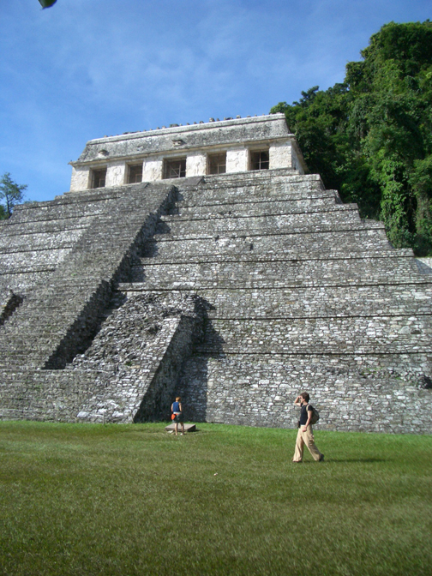
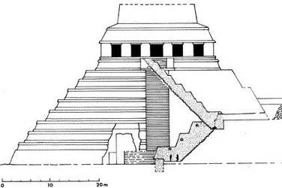
Palenque, Temple of Inscriptions, the Tomb of King Pakal, discovered in 1952 by Alberto Ruz, is set into bedrock at the base

Slide 15
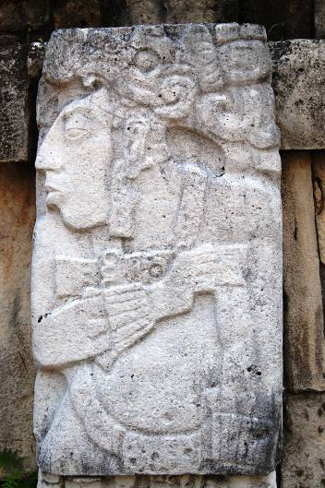
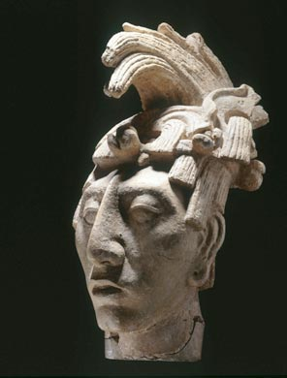
Maya, (right) Portrait head of Pakal, Palenque, Chiapas, Mexico, AD 600-900, Stucco, 16 7/8 x 6 11/16 in. (43 x 17 cm), Museo Nacional de Antropología, -- INAH, Mexico City. The best-known Maya Ajaw, K'inich Janaab' Pakal (Pacal the Great), who ruled from 615 to 683 AD.
Stone relief of Pakal the Great, Palenque

Slide 16
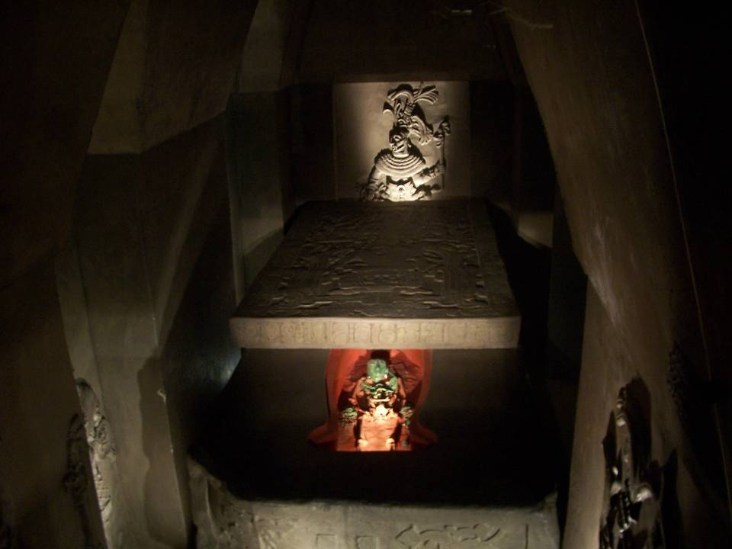
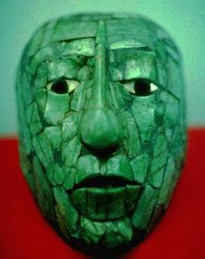
Tomb of Pakal, from the Temple of the Inscriptions, now in the National Anthropology Museum, Mexico City, Mexico. Pakal's body was placed in the limestone sarcophagus and then it was sealed with a 3.8 by 2.2 meter stone lid.

Slide 17
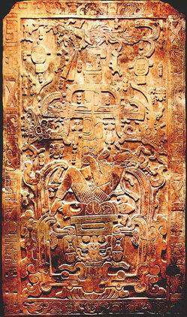
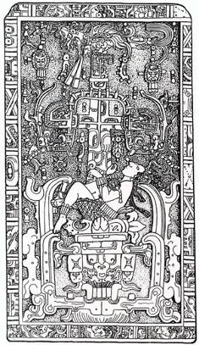
Sarcophagus lid for Lord Pakal, Late Classic Maya – 7th century. The scene represents the instant of Pakal's death and his fall to the Underworld. The open mouth of the Underworld (Xibalba), is carved on the bottom of the plate. The snake's skeleton make up a container that represents the entrance. The snake' lips are curved inward, as though closing over Pakal's falling body.

Slide 18
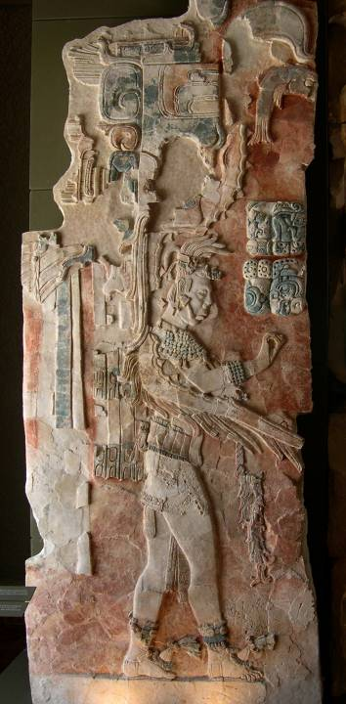
A bas-relief in the Palenque museum that depicts Upakal K'inich, the son of K'inich Ahkal Mo' Naab III, c. 700 AD

Slide 19
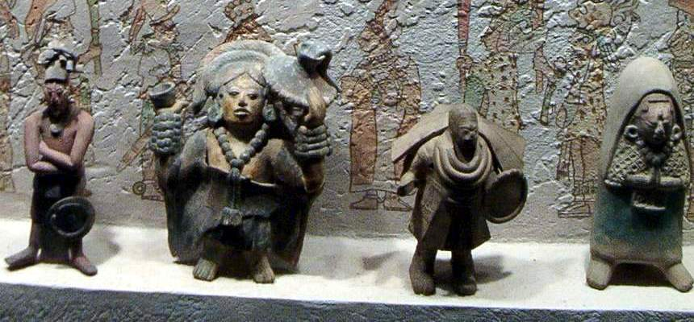
Maya Jaina figurines: Jaina is a small island off the coast of Campeche State, Mexico, and into the southeast corner of the gulf. The necropolis on the island was a massive burial site from the Classic period (100-900 CE) that held many miniature terracotta figurines, each unique. Most represent rulers and nobility. While both solid and hollow figurines have been found, the latter predominate and are usually fitted with a whistle, or with clay pellets that produce a rattle-like sound. Like the figurines themselves, it is not known what function(s) the whistles and rattles served.

Slide 20
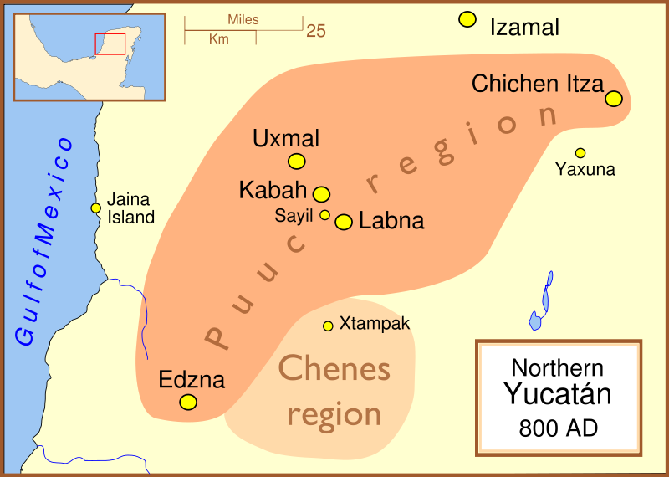
Large numbers of Jaina figurines, considered the finest figurative clay sculptures in the ancient Americas, were found in all inland Maya sites

Slide 21
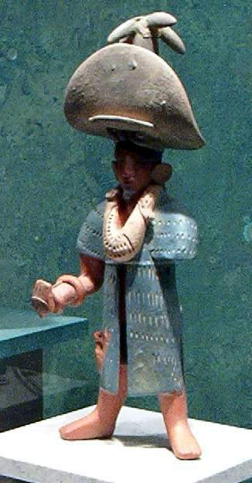
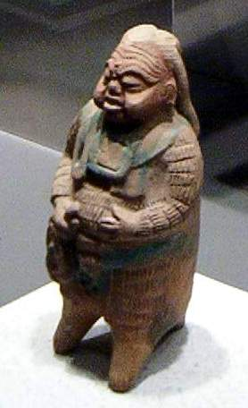

Slide 22
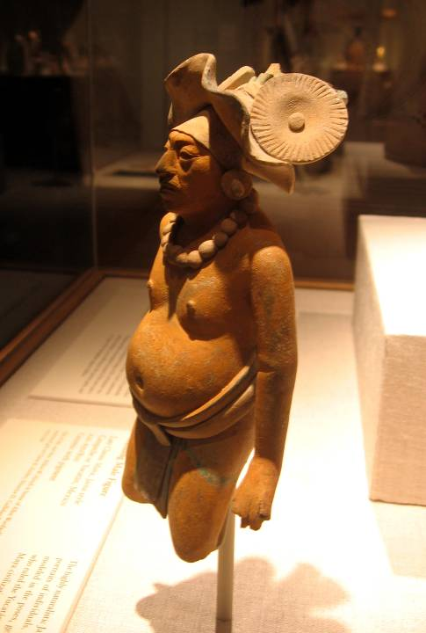
Jaina figurine, Late Classic Maya

Slide 23
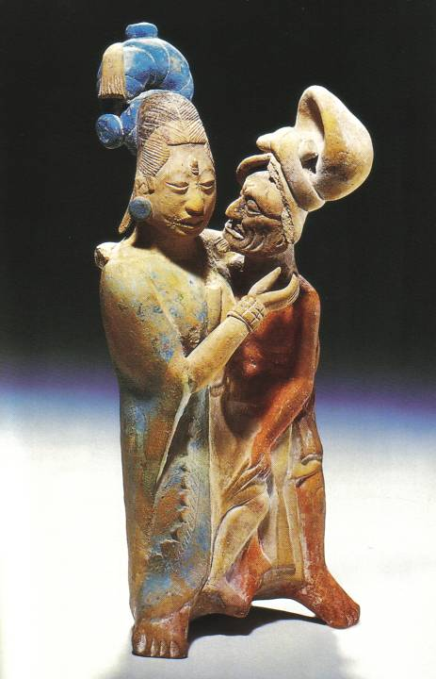
Jaina figurine, Late Classic Maya

Slide 24
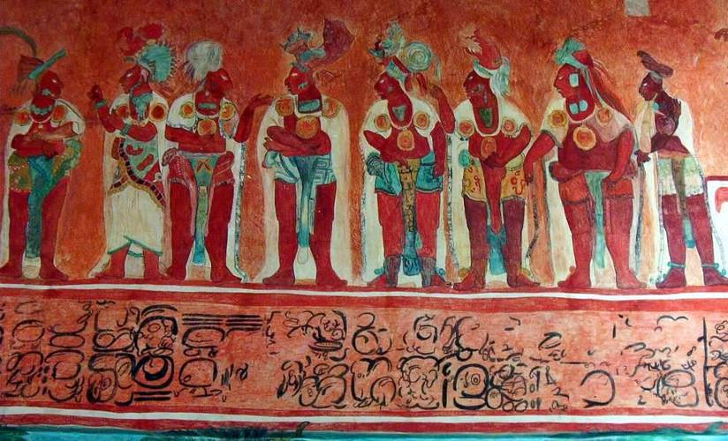
Maya Murals at Bonampak' (on border of Chiapas, Mexico, and Guatemala). The largest and most complete set of murals of ancient Mesoamerica preserved today. The inner walls of the house's three rooms, up to their arched ceilings, were entirely painted with glyphs and narrative events. This scene records the ascension of a new king in 790 CE, his reception by Mayan lords. Photos are from the complete replica at the National Museum of Anthropology and History in Mexico City

Slide 25
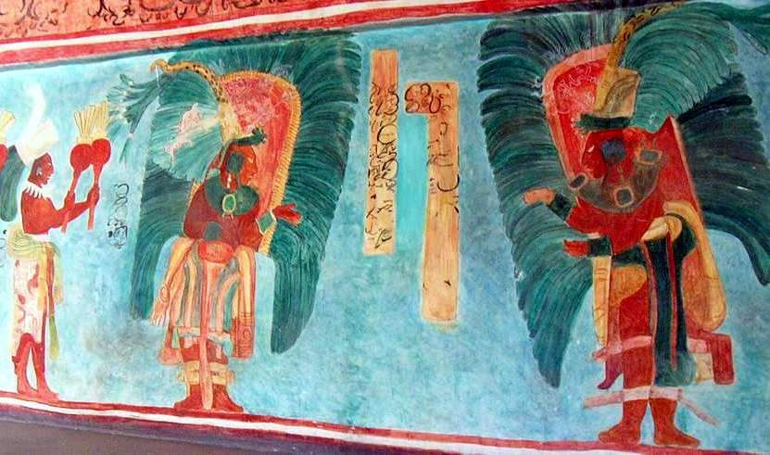
Maya Murals at Bonampak – dedication of building

Slide 26
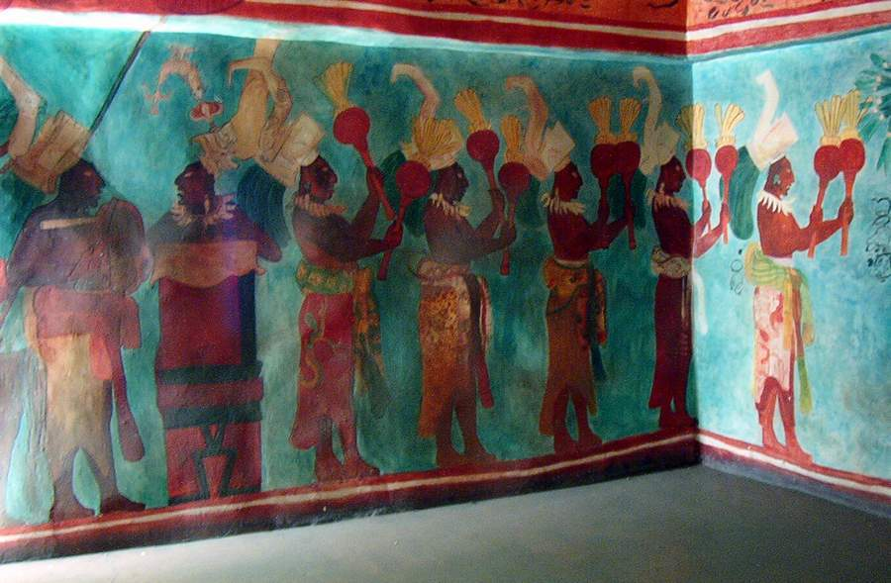
Musicians and dancers performing at the dedication of the building

Slide 27
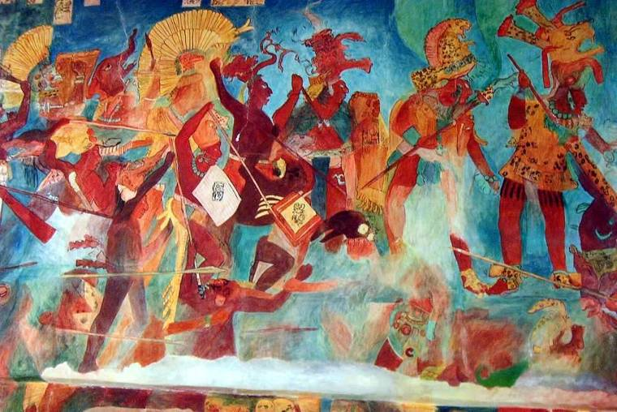
Battle scene in which lords of Bonampak demonstrate their military prowess

Slide 28
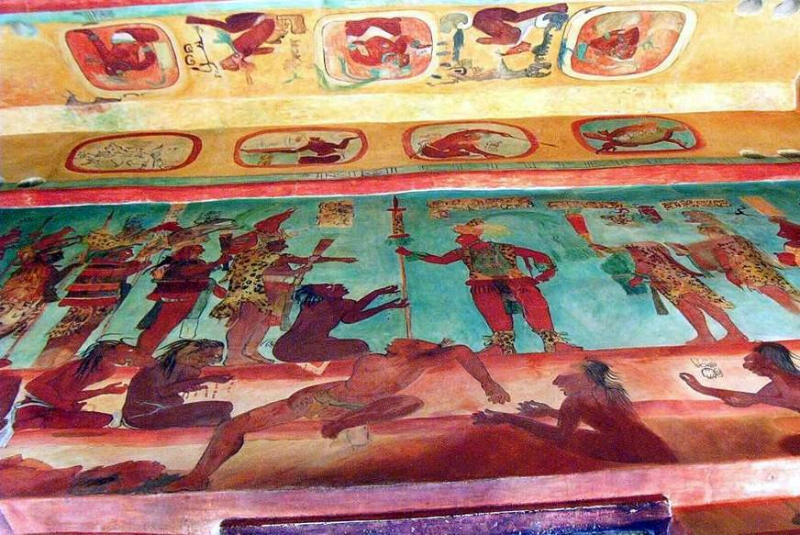
Treatment of war prisoners Bonampak murals

Slide 29
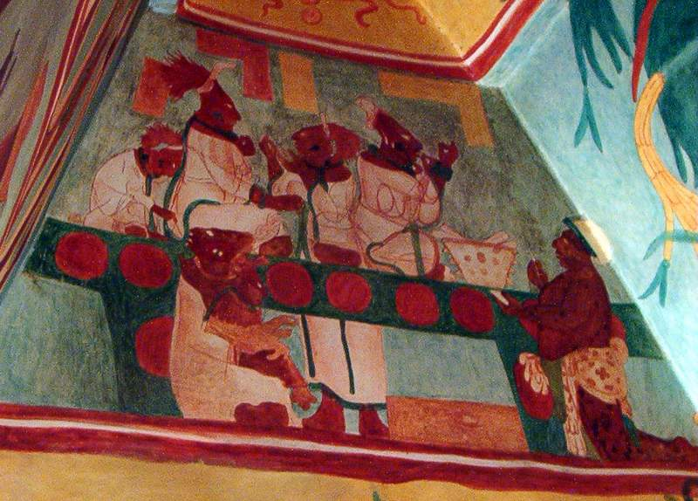
Maya Bonampak mural, Noblewomen practicing bloodletting ritual by piercing tongue or lips

